Slide 1

Goal 6 - TTO
Understand how surfaces affect the behavior of visible light rays.

Slide 2
Types of objects
Translucent
Transparent
Opaque

Slide 3

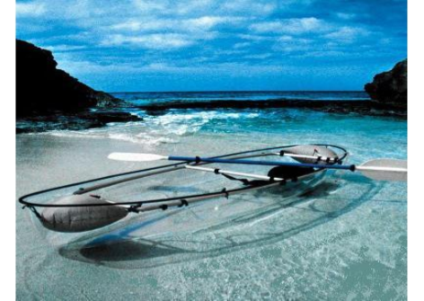
The ability to let certain wavelengths pass through them and objects can be clearly seen. (transmits light)

Slide 4

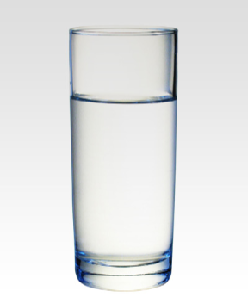
Glass
Acetate
Water
Only really small amounts)

Slide 5


Transparent object
Light Ray
Light passes right through (transmits)

Slide 6

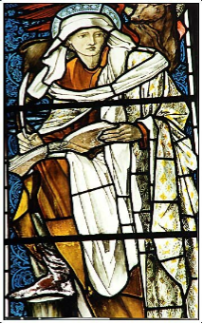
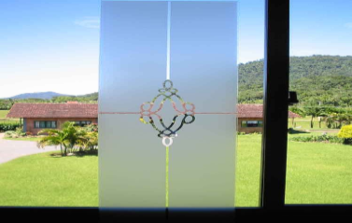
Object only allows some colors of light pass through but not others.
Materials that let light pass through but cannot be clearly seen through.
Diffuse or scatter light.

Slide 7

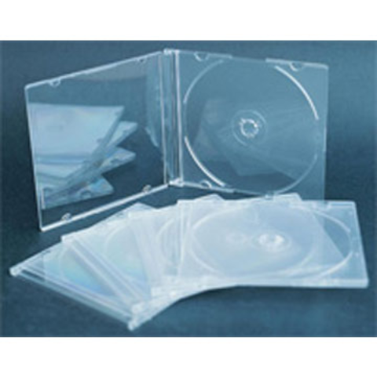
Wax paper
Frosted glass
Lots of water
Tinted windows

Slide 8







Could even reflect some
Translucent object
Light Ray
Scatters light

Slide 9
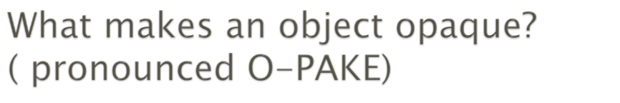
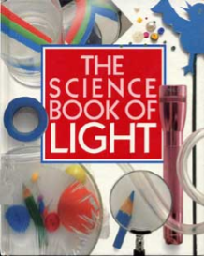
Materials that absorb or reflect ALL of the light
Do not let light pass through

Slide 10

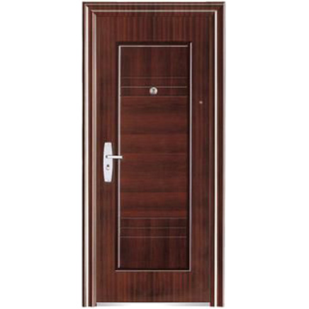

Book
Wall
Door
Desk
Tree

Slide 11
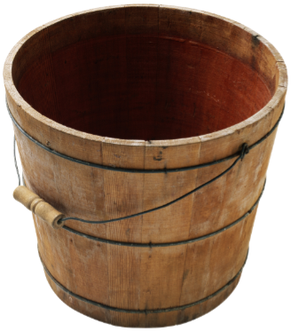
Absorbs (in this case) Or reflects (think: Mirror)
Light Ray

Slide 12

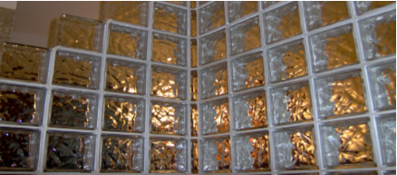
A very thin sample of an opaque object can be translucent.
Adding more layers of a translucent object can scatter the light more and more until it is all reflected, scattered, or absorbed making it opaque.

Slide 13

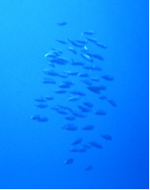
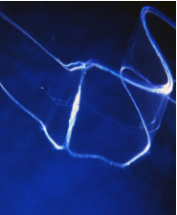
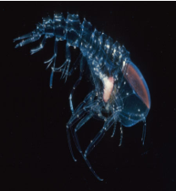
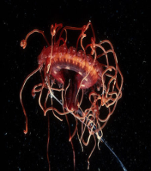
Sunlight can only penetrate so deep. Waters begins as translucent, but as you go deeper, it becomes opaque scattering all of the light at the deepest depths.

Slide 14
