Slide 1
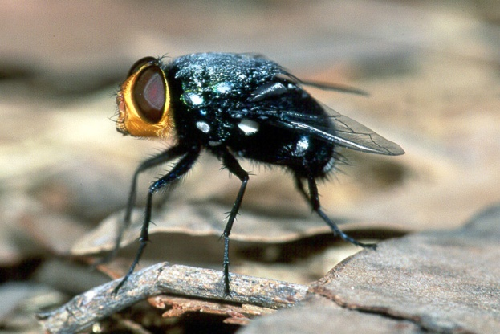
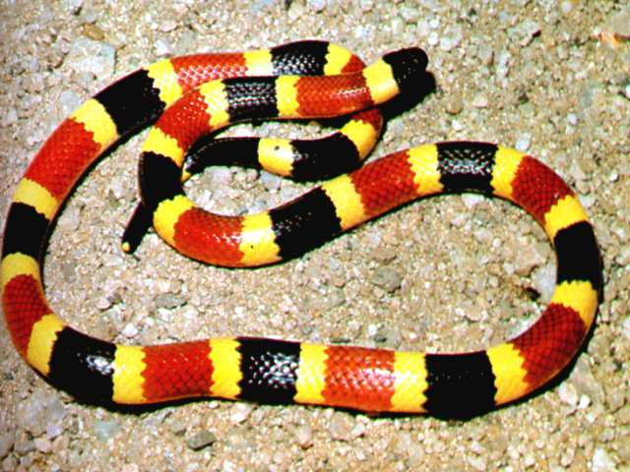
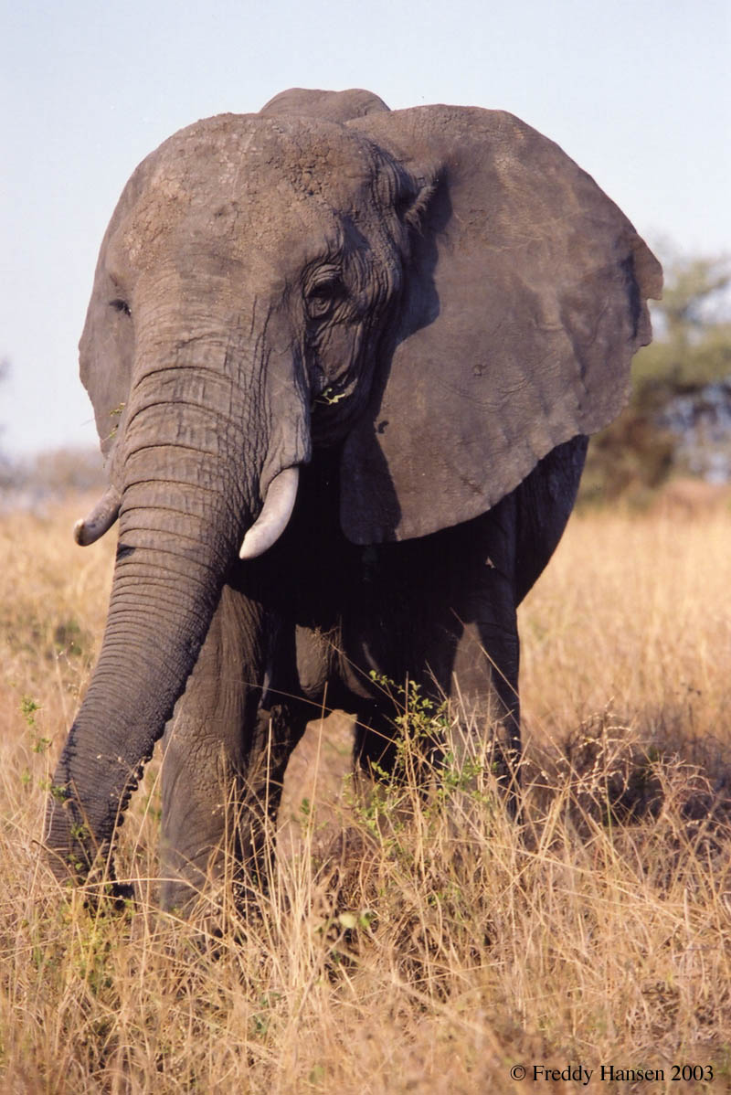
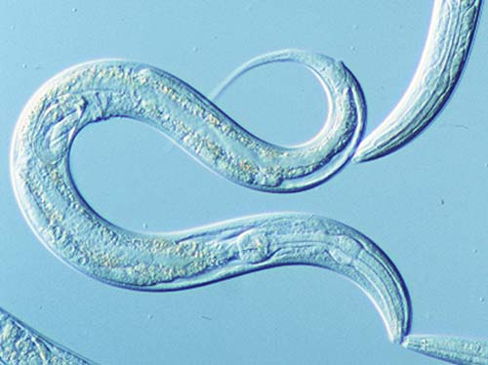
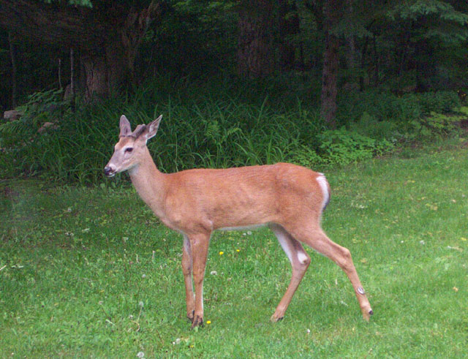
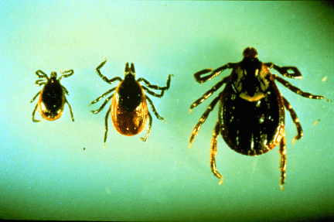
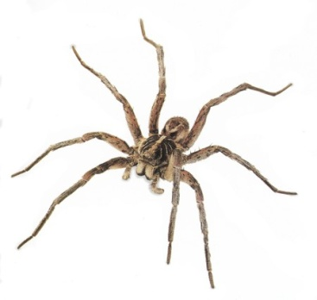
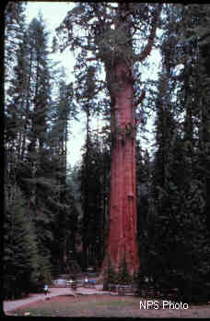
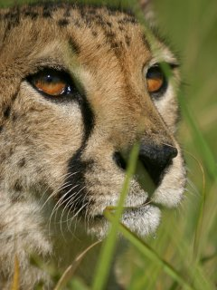
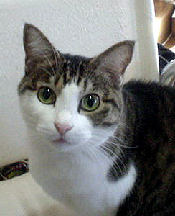
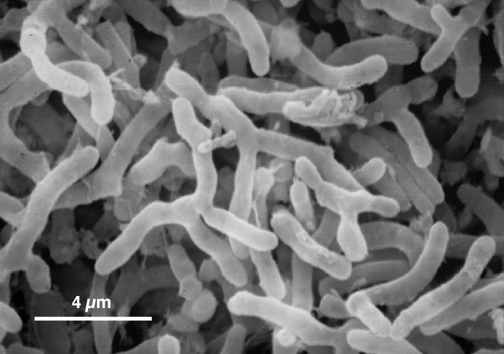
4
Yes, Even I
Am considered
an organism
Characteristics of Living Things
What is the name for something that is living?
An is any living thing.
Organism

Slide 2
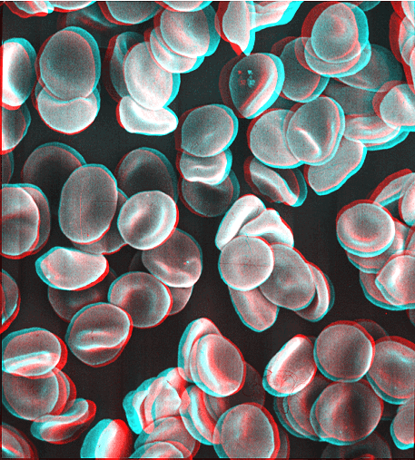
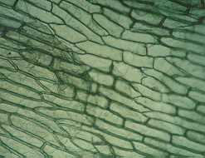
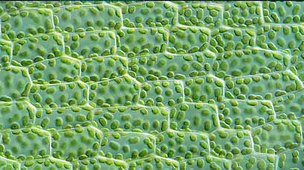
6
There are Six (6) things that all organisms have in common
1. Cellular Organization
All organisms are made up of cells.
If the organism is made of only one (1) cell it is called Unicellular.
If the organism is made of many cells it is called Multicellular.
Definition of a Cell: Basic Unit of structure & function in an organism.

Slide 3
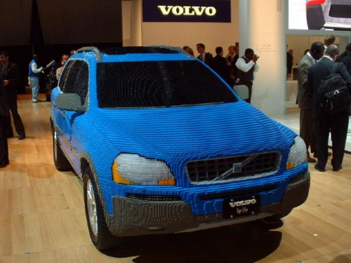
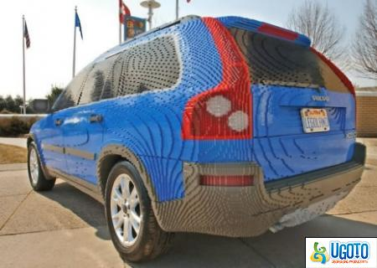
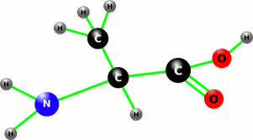
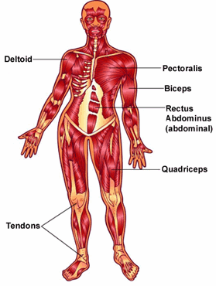
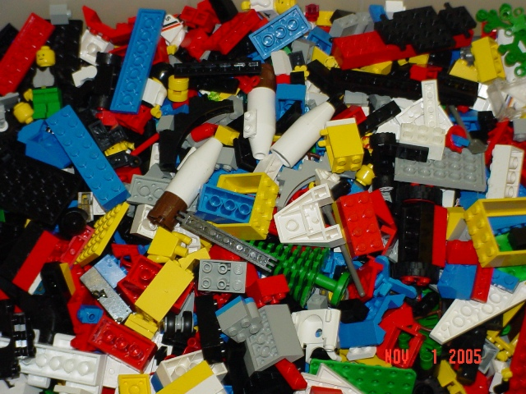
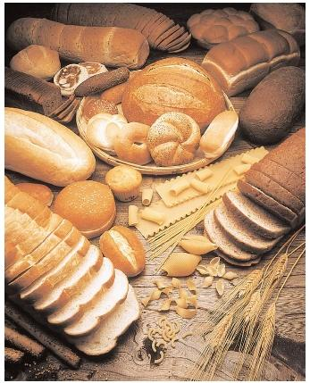
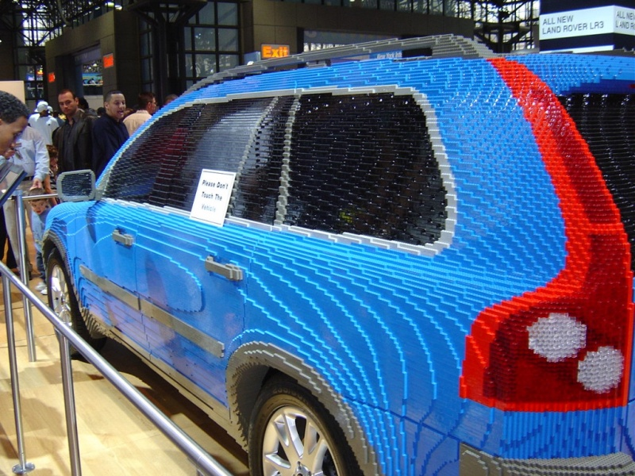
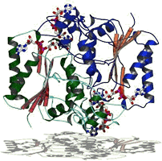
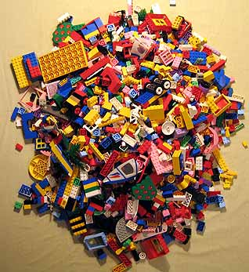
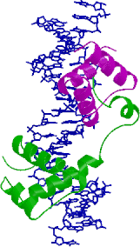
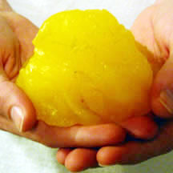
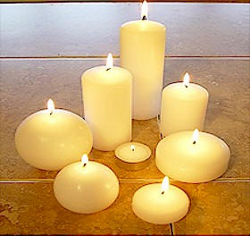
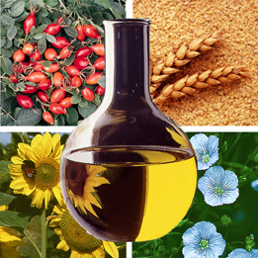
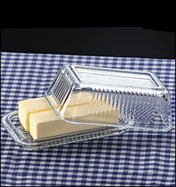
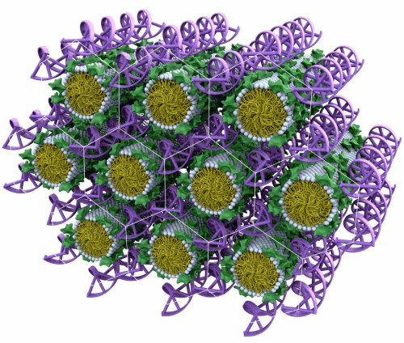
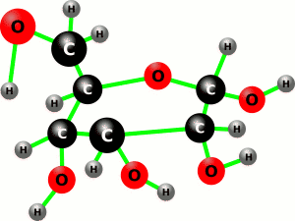
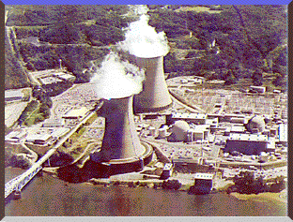
8
2. Chemical Make up– (Genetic Information)
All organisms are made of many of the same things. These things are passed down
Some common materials:
Proteins → Used as building materials (muscles)
Lipids → Used as building materials (fats)
Nucleic Material → Codes Genetic Information (DNA)
Carbohydrates (sugars) → Energy source for organisms
Water ( H₂O ) → Vital for chemical transport & reactions

Slide 4
3. Require Energy
2
All organisms use energy for various reasons.
Movement
Repair
Etc
Growth
Body Functions

Slide 5
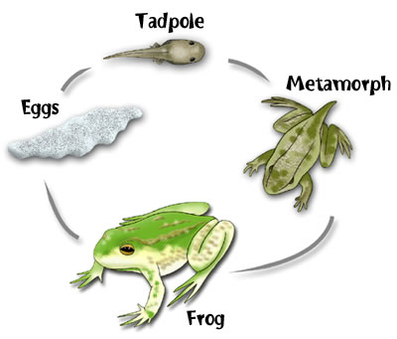
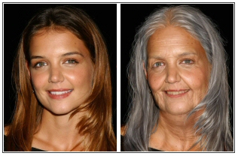
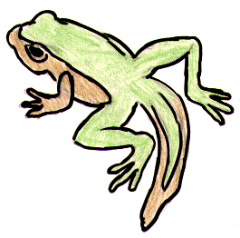
7
4. Evolves and Adapts
Every organism grows and changes during its lifetime.
Organisms will , become more grow and more complex, but can also shrink and become less complex.
Age
Mature,
larger

Slide 6
5. Responds to Stimuli
5
All organisms will react to things that happen in its environment.
These situations are split into two parts:
Stimulus: this is something in the Environment that makes you react such as changes in , , or
light
sound
temperature.
Response: this is any action or change in behavior due to a stimulus.

Slide 7
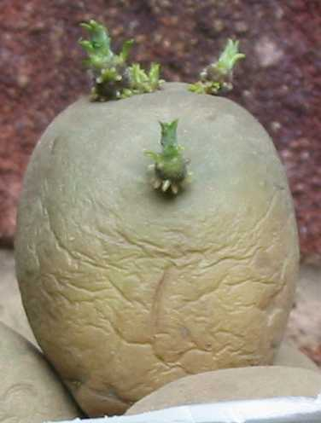
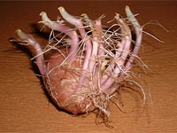
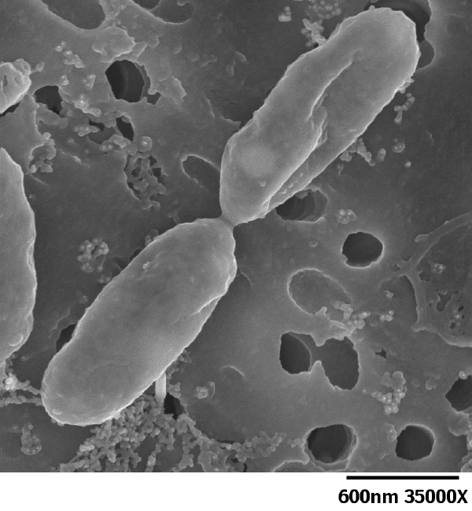
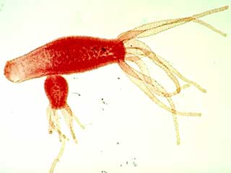
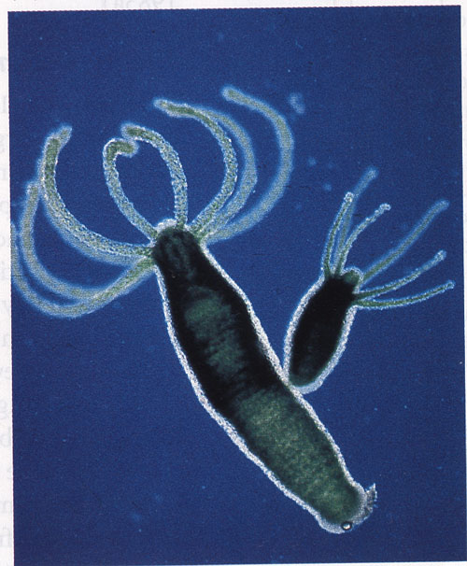
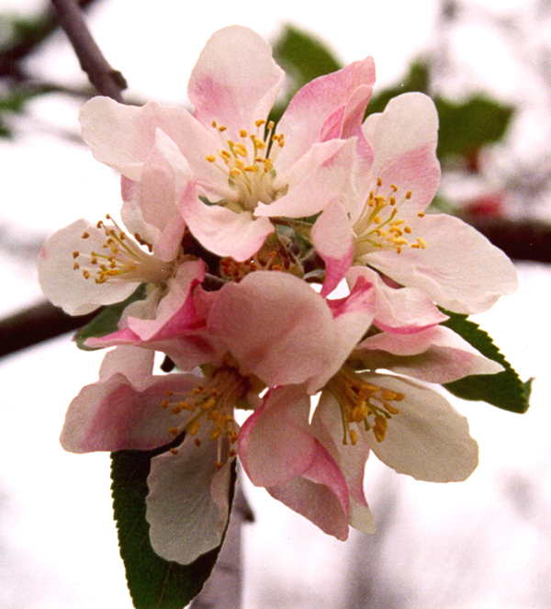
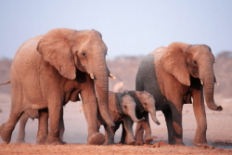
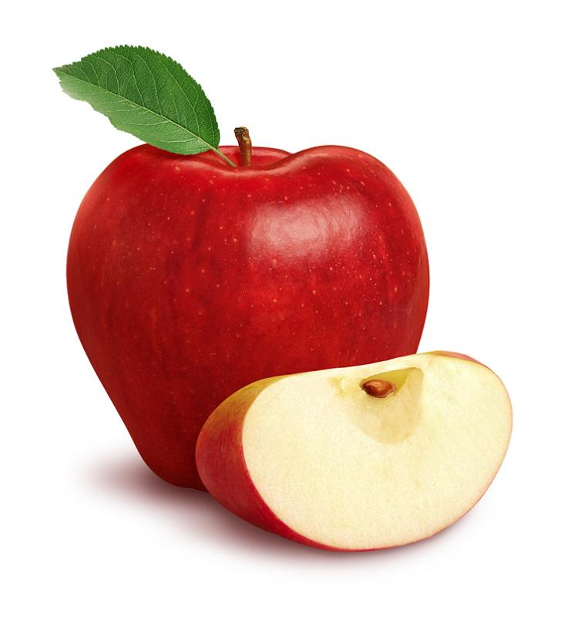
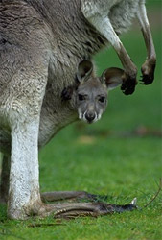
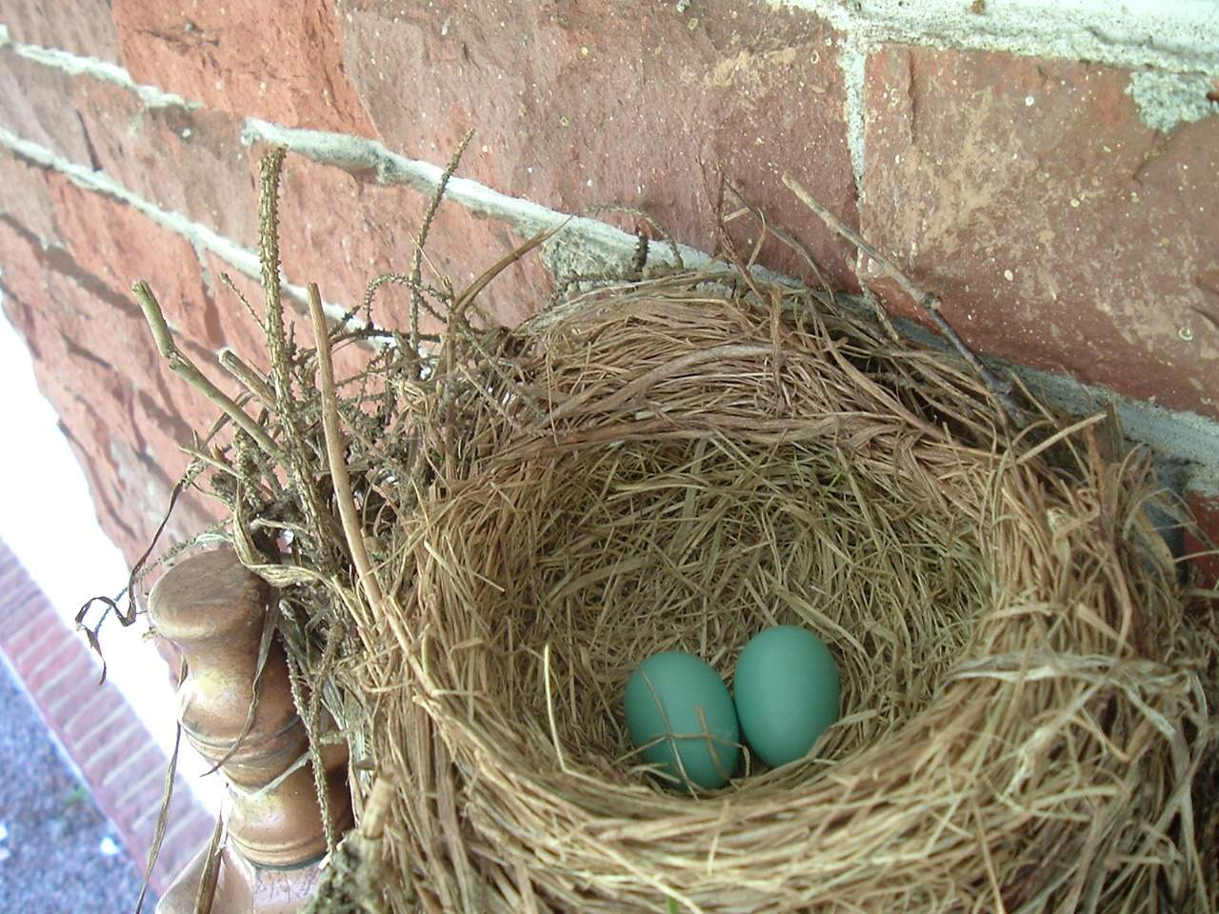
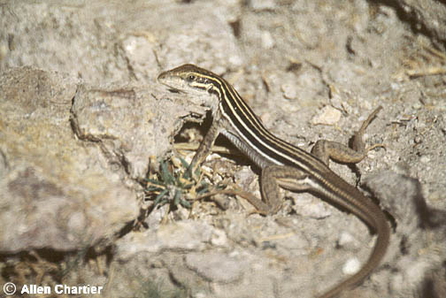
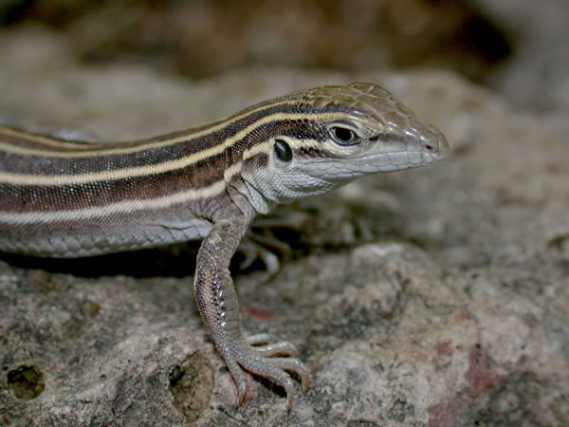
11
6. Reproduction
All organisms must have the ability to reproduce or the species will become extinct.
Desert Grassland Whiptail
This can be done either:
OR
Sexually: when two members of the same species mix their genes together and produce an offspring very similar to themselves.
Asexually: when an individual does not mix genes with another and produces an offspring that is identical to itself. (budding, cloning, etc)

Slide 8
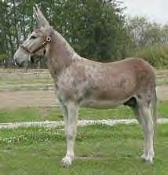
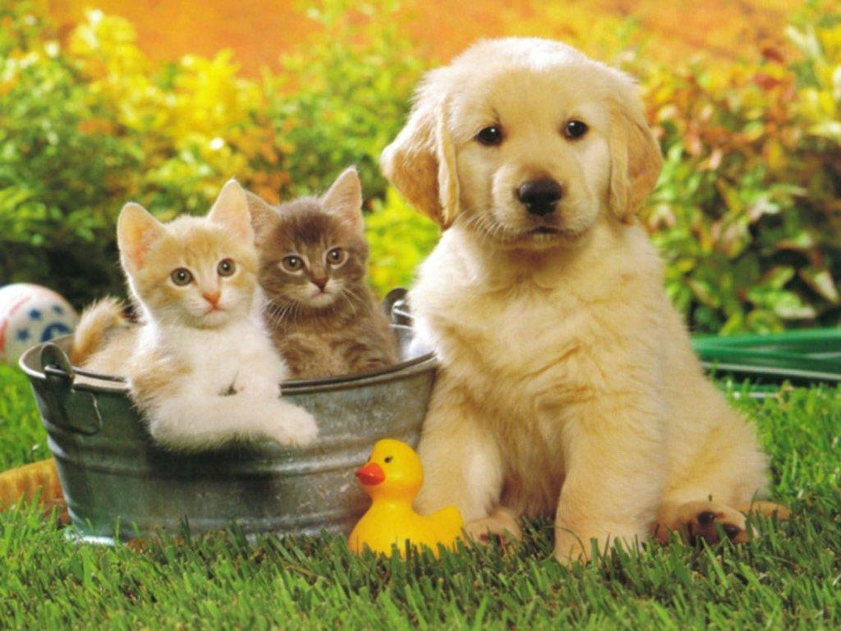
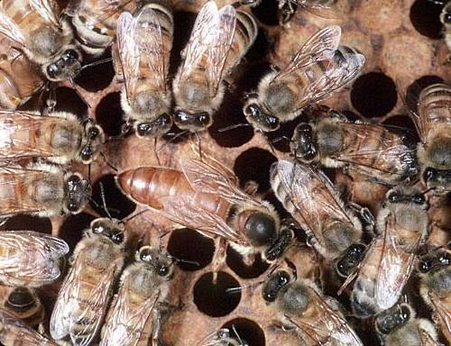
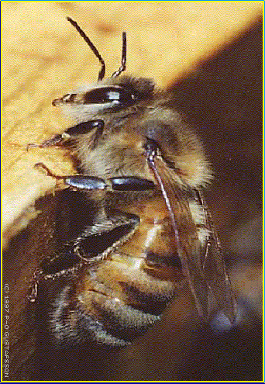
5
Is it Alive?

Slide 9
0
Assignment:
Choose any two objects that you wish. One must be living, the other must be nonliving. Using the six characteristics, explain whether the objects are either living or nonliving. Discuss all 6 characteristics for each object. Draw or attach pictures if you need to. Do not use any more than one piece of paper. Remember, it has to meet all 6 in order to be considered alive!

