Slide 1
Goal 4 – The Periodic Table
Students will be able to use a periodic table to identify elements.

Slide 3
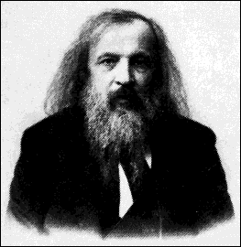
Who is Dmitri Mendeleev?
A russian scientist that discovered a set of patterns that applied to all the elements.

Slide 4
What did he find out about elements?
He noticed that a pattern of properties appeared when he arranged the elements in order of increasing atomic mass.

Slide 5
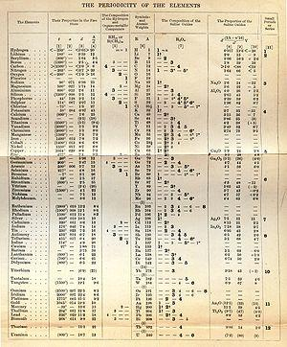
When was the first periodic table published?
1869

Slide 6
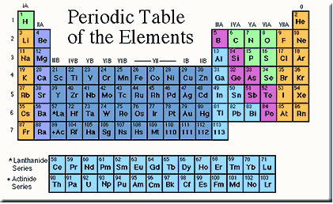
What is the periodic table?
A chart of elements showing the repeating pattern of their properties

Slide 7
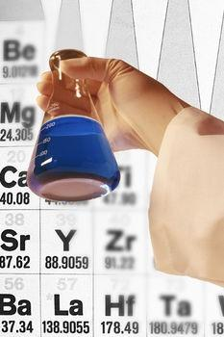
The properties of an element....
can be predicted from its location on the periodic table.

Slide 8
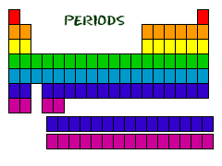
What are periods and groups?
Horizontal rows are called PERIODS
- contains a series of different elements where the properties of each element change.

Slide 9
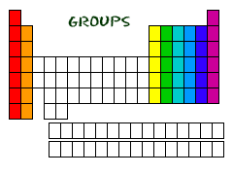
What are periods and groups?
Vertical columns are called GROUPS
- sometimes known as families
- consist of elements with similiar chracteristics.

Slide 10
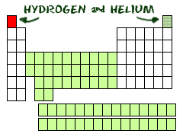

Slide 11
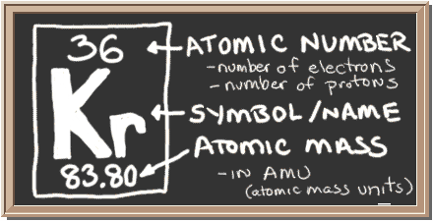
What's in the square?
Atomic number
Chemical symbol
Element name
Atomic mass

Slide 12
Atomic number
Number of protons in the nucleus

Slide 13
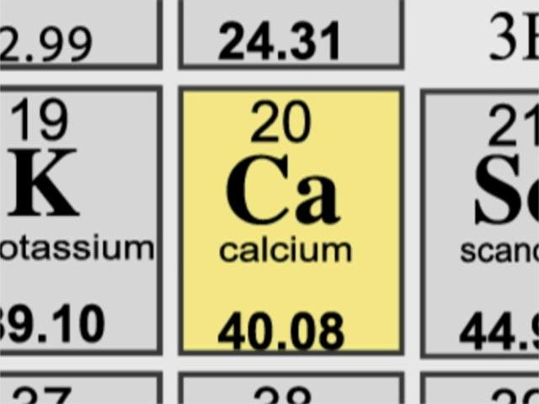
What is a chemical symbol?
Contain one or two letters
Abbreviation of the elements name in English
Previously discovered elements might be characterized by a symbol related to their Latin name

Slide 14
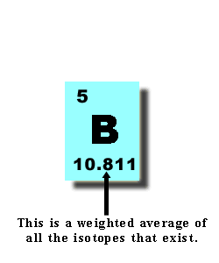
What is average atomic mass?
Measure of the mass of the elements
Sum of number of protons and neutrons found in the nucleus.
Mass Number

Slide 15
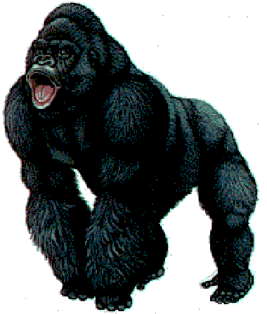
How do I fund the number of Protons, Neutrons, and Electrons?
APE
MAN

Slide 16
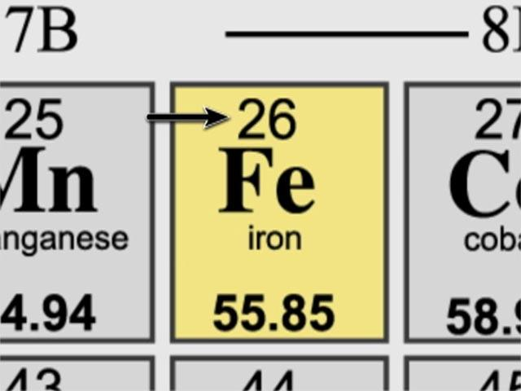
How do I find the number of Protons, Neutrons, and Electrons?
APE
Stands for:
Atomic Number =
Number of Protons =
Number of Electrons.
Atomic number 26 =
26 protons and 26 Electrons

Slide 17
How do I fund the number of Protons, Neutrons, and Electrons?
MAN
Stands for:
Mass number -
Atomic Number =
Number of Neutrons
Mass number is 56 -
Atomic number 26 =
30 Neutrons

Slide 18
Goal
Students will be able to use a periodic table to identify elements.

