Slide 1
Goal 5 – Elements and Compounds

Slide 2
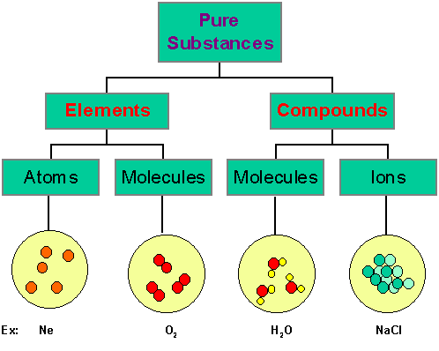
Goal
Students will be able to identify similarities and differences between elements and compounds.

Slide 3
What is an element?
pure substance that cannot be broken down into any other substance by chemical or physical means.

Slide 4
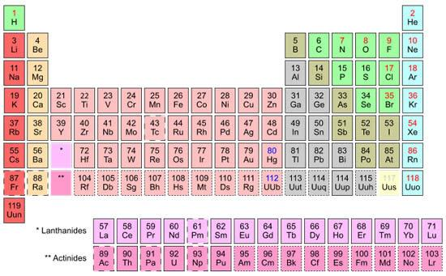
All matter in the universe...
Is made up of over 100 different substances

Slide 5
How can an element be identified?
Specific physical and chemical properties

Slide 6
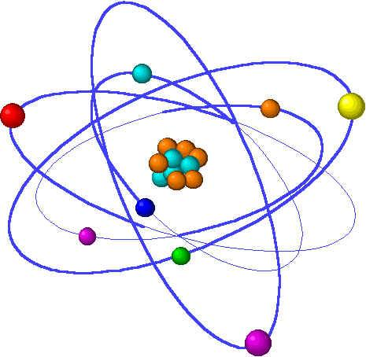
What is an atom?
Basic particle from which all elements are made

Slide 7
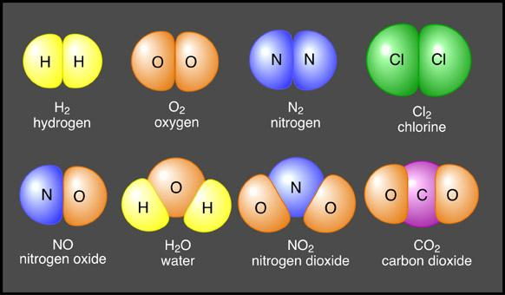
What is a chemical bond?
Force of attraction between two atoms

Slide 8
What is a molecule?
Groups of two or more atoms held together by chemical bonds
Typically referred to as two non-metals.

Slide 9
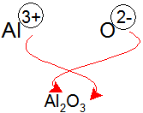
What is a compound?
Pure substance made of two or more elements chemically combined in a set ratio.
Name typically refers to a compound of one metal and one or more non-metals.

Slide 10
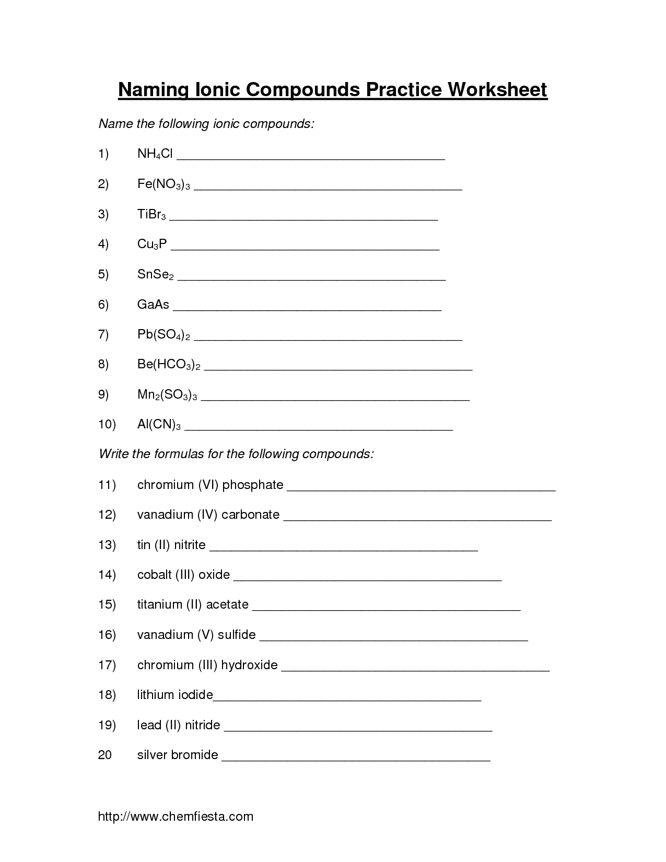
What is a chemical formula?
Shows the elements in the compound and the ratio of atoms.

Slide 11
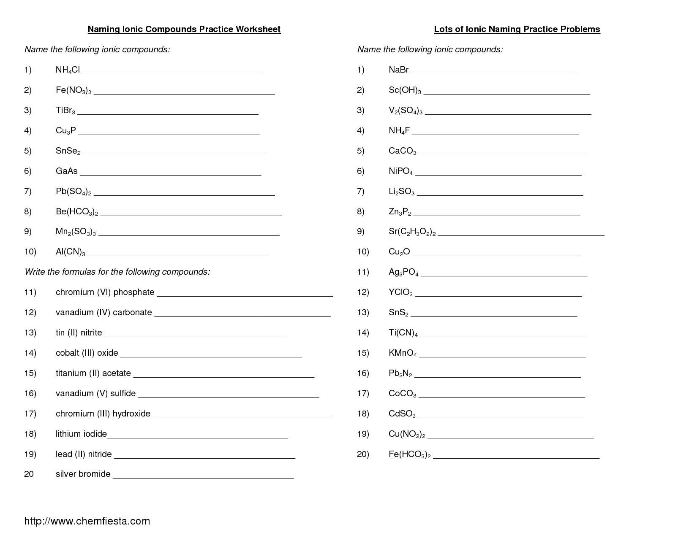
Chemical formula examples:
t

Slide 12
When elements are chemically combined..
they form compounds having properties that are different from those of the uncombined elements.

Slide 13
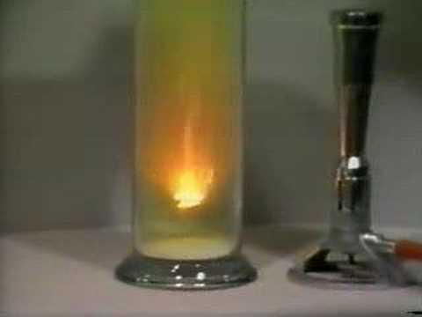

Slide 14
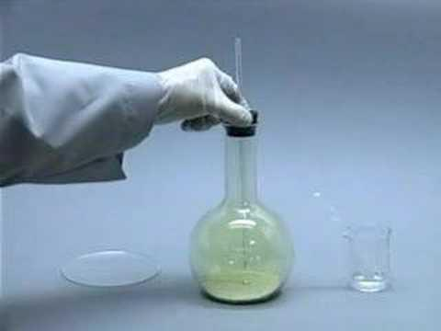

Slide 15
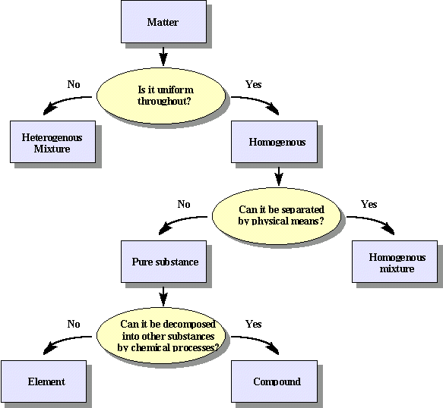
Notes:
//////////////////////

Slide 16
Goal
Students will be able to identify similarities and differences between elements and compounds.

