Slide 1
What creates life?
Well life creates life!
This may seem obvious now, but it was not always so…
Not so long ago, people thought that life could be created. They called this phenomenon…
Spontaneous Generation: the idea that living things can sprout from nonliving things.
Many people lived near shallow lakes or pools. When the lakes would
dry up many of the fish would die, but no one saw any alive. When
the rainy season returned the lakes would fill back up and fish, frogs,
& insects would thrive once again. The people believed that life had a
recipe. Many people spent their lives trying to discover just the right
combination of sticks, mud, rocks, shells, etc to make these kinds of life.

Slide 2
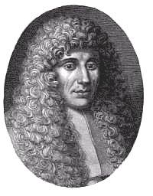
Two Famous Scientists
Francesco Redi:
An Italian doctor in 1600. He is among the first documented scientist to perform experiments to disprove the spontaneous generation theory.
Redi disproved the idea that rotten meat spontaneously created flies. He did this through a perfect example of a controlled experiment. [You will need to know about this experiment]

Slide 3
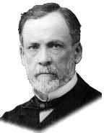
Two Famous Scientists
A French chemist who, in the mid-1800’s finally put an end to the theory of spontaneous generation. People had begun to realize that large, complex organisms could not be created, but many held on to the theory that microscopic life could, since it was simpler. They commonly saw it happen in things such as milk & broth.
Louis Pasteur:
Pasteur developed a flask that would allow air to pass into the container, but no solid particles like dust could get by. Through his experiment, he showed that high heat killed bacteria. He also showed that these liquids spoil because already present bacteria reproduce, or bacteria from the air are allowed to get in. [You will need to know about this experiment]

Slide 4
Four Basic Needs of All Living Things
Energy
All organisms need to get their energy somewhere. Some people call this Food.
There are three different types of organisms if you categorize them by how they get their food.
A. Autotroph: in Greek “Auto” means “Self” & “Troph” means “Feeding”
An Autotroph then, is an organism that can create food
within itself.
Examples: All Plants are Autotrophs. Where do they get the energy to create their own food?
B. Heterotroph: in Greek “Hetero” means “others”
A Heterotroph then, is an organism that uses others for food.
Examples: Any Animal, whether it eats meat or plants. Where does
the energy they eat ultimately originate?
The Sun
The SUN!

Slide 5
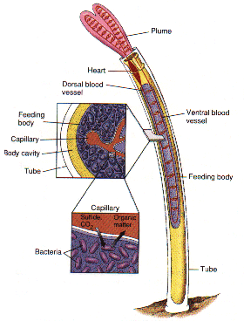
C. Chemioautotroph: In Greek “Chemo” means “Useful Thing” but in modern times we use it to mean Chemicals.
A Chemioautotroph creates it’s own food from chemicals in its environment.
Examples: Bacteria that live near Deep Ocean Vents
use Hydrogen Sulfide (H2S) to create energy.
H2S would be lethal in even small doses to any of you. Plus, these bacteria live in water that can be warmer than 80 °C (186+ °F) These creatures (and those that feed upon them) are the ONLY creatures on
Earth that do not depend on the SUN for survival.

Slide 6
2. Water
Water is known as the Universal Solvent.
This is because it can dissolve nearly every chemical.
Every organism needs water in order to move nutrients and wastes around inside the body. In humans, nutrients are constantly being brought to organs and waste is taken away from organs. All of this happens in the blood, which is 92% water.
Water is also important because many of the chemical reactions that your body needs to survive cannot happen without water. Medicines are designed to be taken with water. If you eat a pill without a glass of water, that medicine will not work nearly as well.
Many organisms can live for weeks without any food, but very few can survive for more than a couple of days without water!

Slide 7
3. Living Space
When organisms are competing
over living space their options
are to force the others out,
or move. Not all organisms
have the option of
moving (plants).
“A man’s home is his castle!” Well, people aren’t the only ones that need space. Every organism needs a place to live. When that space is limited, some organisms can be very effective at keeping others out. This is called competition.
Competition occurs whenever there is any resource that must be shared between two organisms. Anything that limits the number of organisms that can live in a certain place is called a Limiting Factor. Competition is the driving force behind Evolution.

Slide 8
4. Stable Internal Condition
Every organism needs to be able to maintain its inside functions even under the most drastic environmental changes.
When talking about temperature, some animals are “warm blooded” while others are “cold blooded.” We are warm blooded because we can use energy to keep our internal temperature high. This allows us to always be active. Reptiles and fish cannot do this; they must bask in the sun to stay warm. When the climate gets cold, their body temperature drops and they cannot function properly.
Another example is clams that live on ocean beaches. These organisms need to survive under water during high tide and also exposed to air during low tide. This is no easy feat; most organisms would die within half-a-day in this environment. Clams can seal themselves so tight, though, that they trap enough ocean water inside them during high tide that they don’t dry out during low tide.
Being able to do this is called Homeostasis.
In Greek “Homeo” is “Same” & “Stasis” is “State”

